Slide 1


Word recognition
Guénon Marie
Achard Jean-Paul
Favreau Jean-Dominique
MAM4 G1
Notes:
JP

Slide 2
Introduction
Home automation system
Disable persons
Games
Guénon Marie
Achard Jean-Paul
Favreau Jean-Dominique
MAM4
Notes:
JP

Slide 3
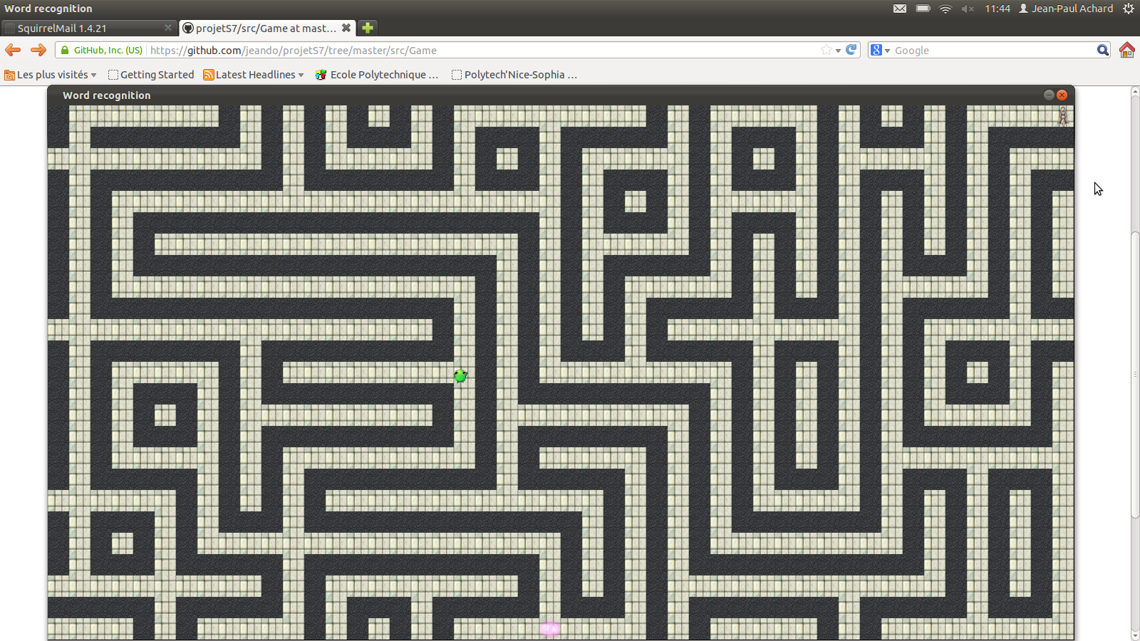
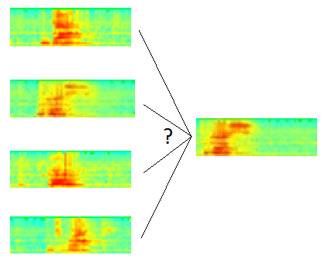
Introduction
Game by voice control
Guénon Marie
Achard Jean-Paul
Favreau Jean-Dominique
MAM4
Notes:
JP

Slide 4
Content
Sound processing
From signal to spectrogram
Mel’s scale and filter bank
Comparison
Existing methods
Dynamic Time Warping
Method improvement
Results
Human Machine Interface
Menu
How to play
Guénon Marie
Achard Jean-Paul
Favreau Jean-Dominique
MAM4
Notes:
JD

Slide 5
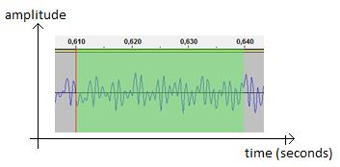
Sound processing
I. Sound processing
a. From signal to spectrogram
b. Mel’s scale and filter bank
II. Comparison
III. Human Machine
Interface
Sound recording
Time split
Treatment of each slice
Guénon Marie
Achard Jean-Paul
Favreau Jean-Dominique
MAM4
Notes:
JP

Slide 6
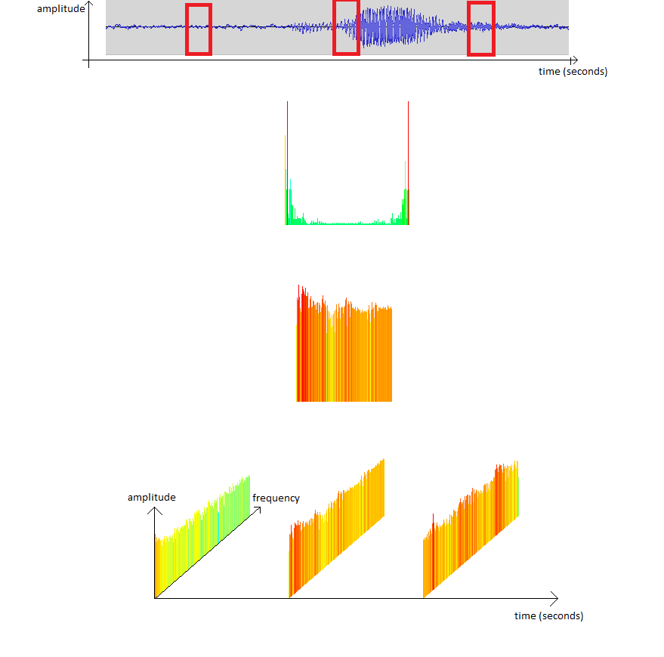

From signal to spectrogram
I. Sound processing
a. From signal to spectrogram
b. Mel’s scale and filter bank
II. Comparison
III. Human Machine
Interface
FT
processing
Notes:
JP
TNS

Slide 7

Spectrogram
I. Sound processing
a. From signal to spectrogram
b. Mel’s scale and filter bank
II. Comparison
III. Human Machine
Interface
2D view spectrogram
« gauche »
Guénon Marie
Achard Jean-Paul
Favreau Jean-Dominique
MAM4
Notes:
JP
TNS

Slide 8
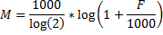
Mel’s scale and filter bank
I. Sound processing
a. From signal to spectrogram
b. Mel’s scale and filter bank
II. Comparison
III. Human Machine
Interface
Mel’s scale:
Reduce the importance of high frequencies
From Hz to Mel
Guénon Marie
Achard Jean-Paul
Favreau Jean-Dominique
MAM4
Notes:
M
less finely perceived by the human ear
the perception intensity of a stimulus does not linearly increase as a function of its power, but exponentially.
more representative of the human hearing

Slide 9
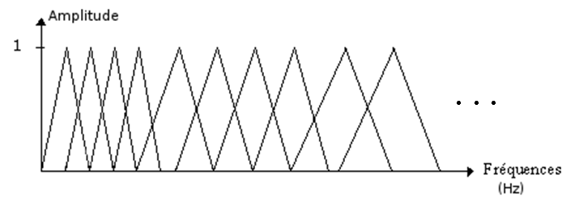
Mel’s scale and filter bank
I. Sound processing
a. From signal to spectrogram
b. Mel’s scale and filter bank
II. Comparison
III. Human Machine
Interface
Filter bank:
Reduce the number of frequencies considered
Uniform on the Mel’s scale, non uniformly on the frequency scale
Guénon Marie
Achard Jean-Paul
Favreau Jean-Dominique
MAM4
Notes:
M

Slide 10
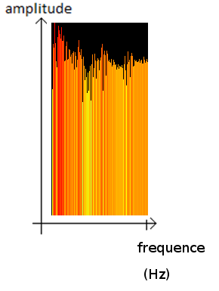
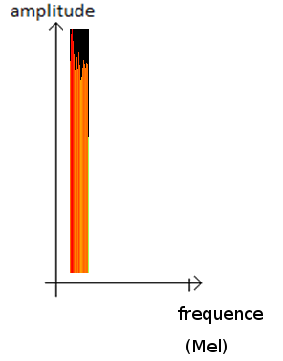
Mel’s scale and filter bank
I. Sound processing
a. From signal to spectrogram
b. Mel’s scale and filter bank
II. Comparison
III. Human Machine
Interface
Example:
Guénon Marie
Achard Jean-Paul
Favreau Jean-Dominique
MAM4
Notes:
M

Slide 11
Comparison
I. Sound processing
II. Comparison
a. Existing methods
b. Dynamic Time Warping
c. Method improvement
d. Results
III. Human Machine
Interface
“Bas”
“Gauche”
“Haut”
“Droite”
Guénon Marie
Achard Jean-Paul
Favreau Jean-Dominique
MAM4
Notes:
JP

Slide 12
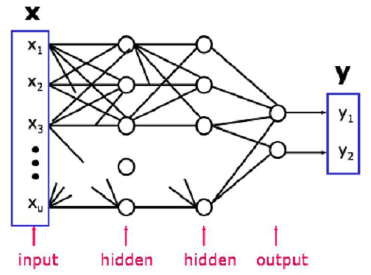
Existing methods
I. Sound processing
II. Comparison
a. Existing methods
b. Dynamic Time Warping
c. Method improvement
d. Results
III. Human Machine
Interface
Artificial neuronal networks:
Guénon Marie
Achard Jean-Paul
Favreau Jean-Dominique
MAM4
Notes:
JP
Infographie
In our case, we have a small vocabulary (about twenty words) based on a single-speaker (considering that during a phase of recording a single person has to speak). That’s why it is not necessary here to use a neural network that is heavier to implement (on a computational point) and it suffices to change the comparison database for each new user.

Slide 13
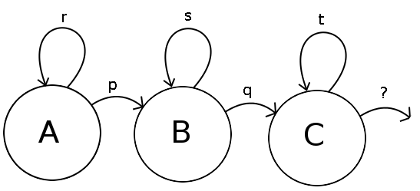
Existing methods
I. Sound processing
II. Comparison
a. Existing methods
b. Dynamic Time Warping
c. Method improvement
d. Results
III. Human Machine
Interface
Hidden Markov model
Guénon Marie
Achard Jean-Paul
Favreau Jean-Dominique
MAM4
Notes:
JP
However, it is not interesting in this case to use the hidden Markov model, because it is too complex for the small vocabulary we are using. So it is sufficient for us to use the Dynamic Time Warping which is a simplification of the hidden Markov model.

Slide 14
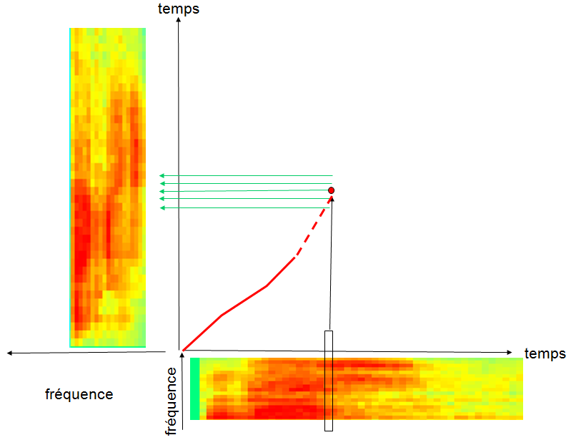
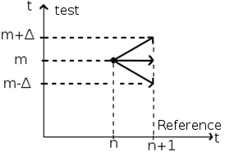
Dynamic Time Warping
Example of minimal path
Notes:
JD

Slide 15
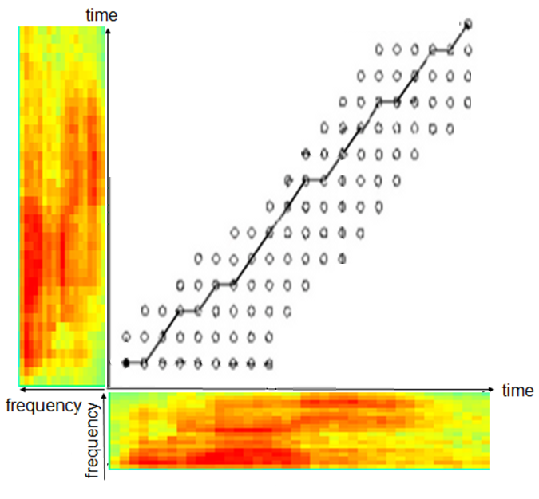
Dynamic Time Warping
I. Sound processing
II. Comparison
a. Existing methods
b. Dynamic Time Warping
c. Method improvement
d. Results
III. Human Machine
Interface
Example of minimal path
Guénon Marie
Achard Jean-Paul
Favreau Jean-Dominique
MAM4
Notes:
JD

Slide 16
Dynamic Time Warping
I. Sound processing
II. Comparison
a. Existing methods
b. Dynamic Time Warping
c. Method improvement
d. Results
III. Human Machine
Interface
Limits:
Euclidean distance
Slower for big vocabularies
Word width
Guénon Marie
Achard Jean-Paul
Favreau Jean-Dominique
MAM4
Notes:
JD
The difference between /a/ and /wa/ from “bas” and “droite”
Mahalanobis distance

Slide 17
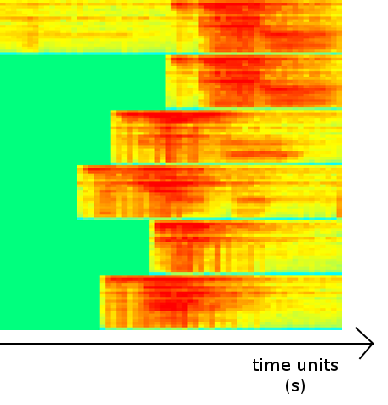
Method improvement
I. Sound processing
II. Comparison
a. Existing methods
b. Dynamic Time Warping
c. Method improvement
d. Results
III. Human Machine
Interface
DTW parameters modifications
Word beginning detection
Global approach on DTW
Guénon Marie
Achard Jean-Paul
Favreau Jean-Dominique
MAM4
Notes:
M
By modifying
Begining: difference of energy

Slide 18
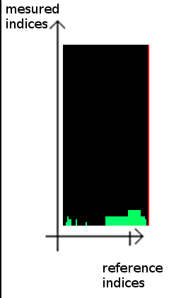
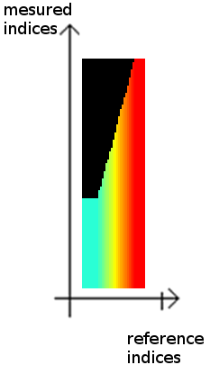
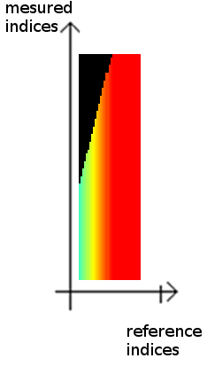
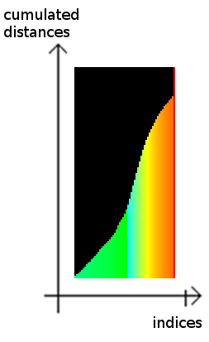
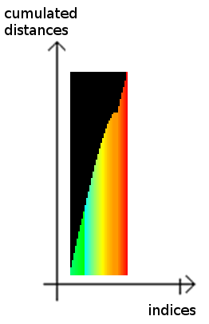
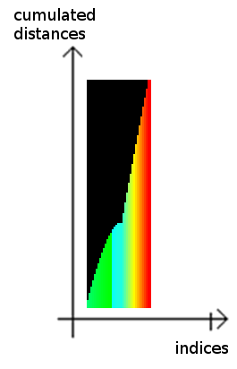
Results
Local DTW / Median DTW / Global DTW
I. Sound processing
II. Comparison
a. Existing methods
b. Dynamic Time Warping
c. Method improvement
d. Results
III. Human Machine
Interface
MAM4

Slide 19
Results
I. Sound processing
II. Comparison
a. Existing methods
b. Dynamic Time Warping
c. Method improvement
d. Results
III. Human Machine
Interface
Words Method …. | “gauche”, “droite”, “haut”, “bas” | “Bonjour”, “Hello”, “Maison”, ”Placard” | “vacherin”, “tiramisu”, “moelleux”, “bûche” | “Riri”, “Fifi”, “Loulou”, “toto”
DTW local | 62,5% | 80% | 70% | 70%
DTW local and beginning detection | 62,5% | 80% | 70% | 70%
DTW median and beginning detection | 85% | 85% | 98% | 65%
DTW global and beginning detection | 95% | 90% | 98% | 85%
Guénon Marie
Achard Jean-Paul
Favreau Jean-Dominique
MAM4
Notes:
M

Slide 20
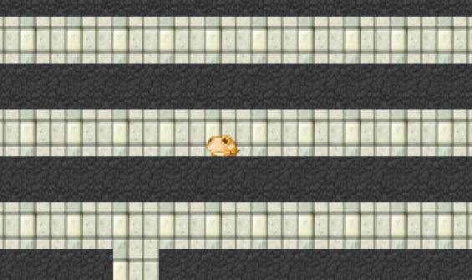
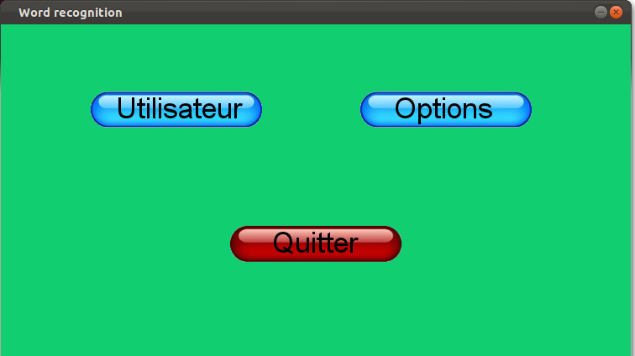
Human Machine Interface
I. Sound processing
II. Comparison
III. Human Machine
Interface
a. Menu
b. How to play
Guénon Marie
Achard Jean-Paul
Favreau Jean-Dominique
MAM4
Notes:
JD
C++

Slide 21
Menu
I. Sound processing
II. Comparison
III. Human Machine
Interface
a. Menu
b. How to play
Guénon Marie
Achard Jean-Paul
Favreau Jean-Dominique
MAM4
Notes:
JD

Slide 22
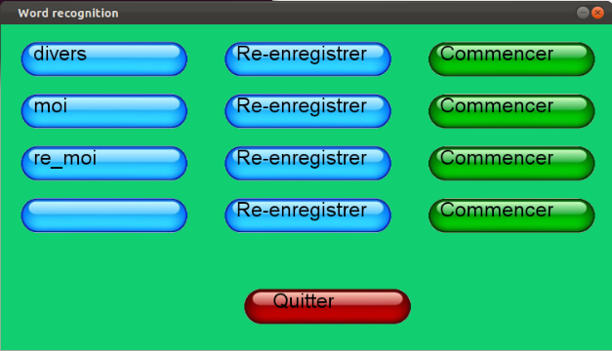
Menu
I. Sound processing
II. Comparison
III. Human Machine
Interface
a. Menu
b. How to play
Guénon Marie
Achard Jean-Paul
Favreau Jean-Dominique
MAM4
Notes:
JD

Slide 23
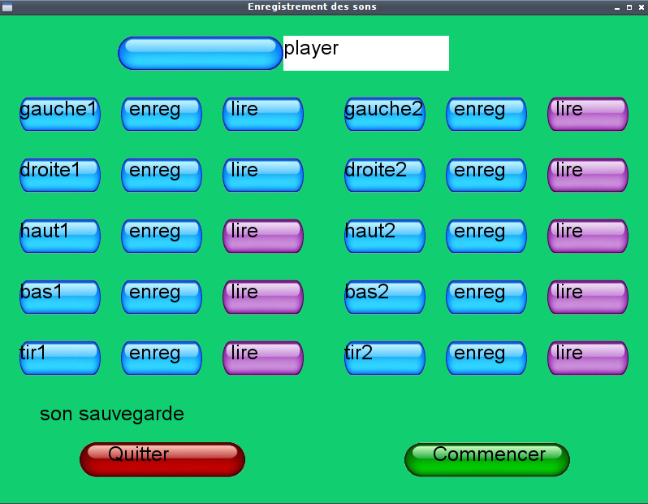
Menu
I. Sound processing
II. Comparison
III. Human Machine
Interface
a. Menu
b. How to play
Guénon Marie
Achard Jean-Paul
Favreau Jean-Dominique
MAM4
Notes:
JP

Slide 24
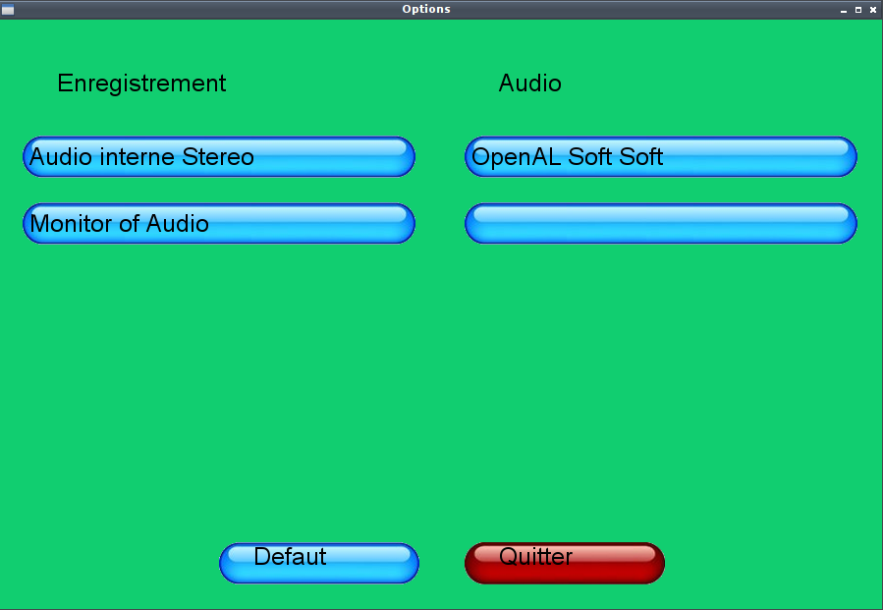
Menu
I. Sound processing
II. Comparison
III. Human Machine
Interface
a. Menu
b. How to play
Guénon Marie
Achard Jean-Paul
Favreau Jean-Dominique
MAM4
Notes:
JP

Slide 25
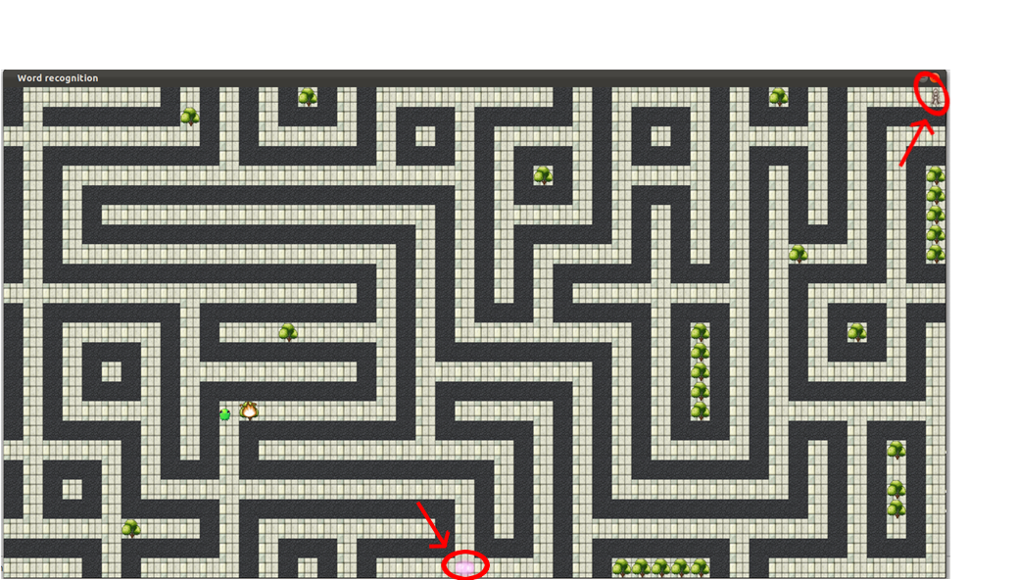
Human Machine Interface
I. Sound processing
II. Comparison
III. Human Machine
Interface
a. Menu
b. How to play
Guénon Marie
Achard Jean-Paul
Favreau Jean-Dominique
MAM4
Notes:
M
Multi thread / synchronisation

Slide 26
Human Machine Interface
I. Sound processing
II. Comparison
III. Human Machine
Interface
a. Menu
b. How to play
Way in:
Way out:
Guénon Marie
Achard Jean-Paul
Favreau Jean-Dominique
MAM4
Notes:
M

Slide 27
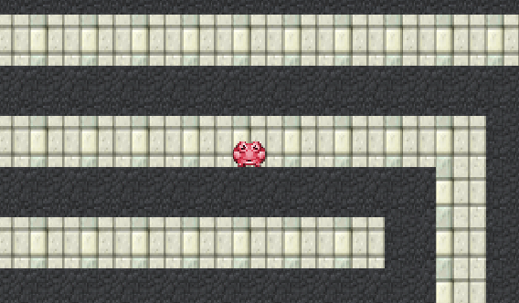
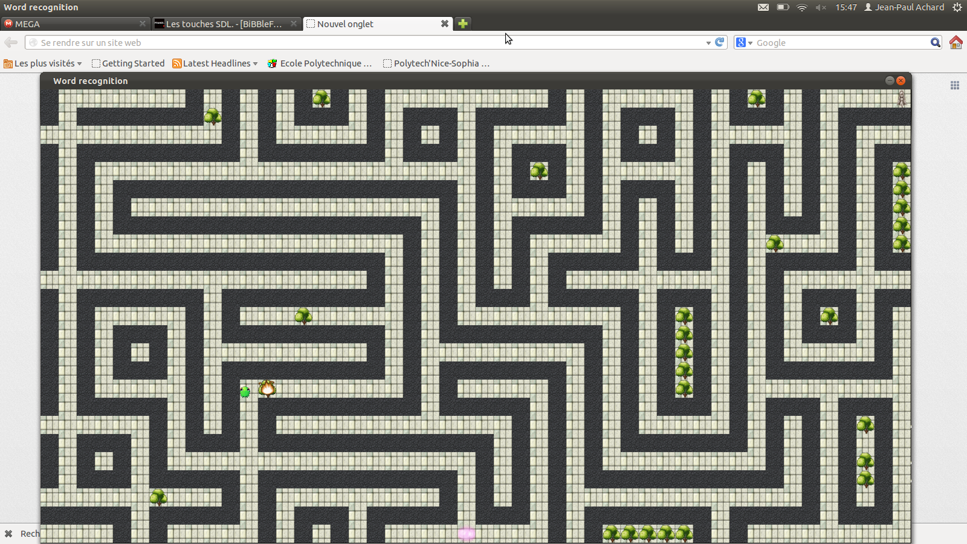
Human Machine Interface
I. Sound processing
II. Comparison
III. Human Machine
Interface
a. Menu
b. How to play
Moving:
Waiting:
Wall:
Fire:
Guénon Marie
Achard Jean-Paul
Favreau Jean-Dominique
MAM4
Notes:
M

Slide 28
Human Machine Interface
I. Sound processing
II. Comparison
III. Human Machine
Interface
a. Menu
b. How to play
Guénon Marie
Achard Jean-Paul
Favreau Jean-Dominique
MAM4
Notes:
M
Multi thread / synchronisation

Slide 29
Conclusion
Interesting project
Apply our courses(NSP, Infographie, C++)
Deepen our knowledge
Others upgrades?
Guénon Marie
Achard Jean-Paul
Favreau Jean-Dominique
MAM4
Notes:
M
Use of GitHub (revision control)
Random tree

Slide 30
References
J. Leroux « Dynamic time warping », « HMI », TNS
Wikipedia
J. Mariani « Advances and trends in automatic speech recognition », p245-252, 1990
Source code : https://github.com/jeando/projetS7
…
Guénon Marie
Achard Jean-Paul
Favreau Jean-Dominique
MAM4
Notes:
M

Slide 31

Let’s practice !

Slide 32

Do you have any question?
Guénon Marie
Achard Jean-Paul
Favreau Jean-Dominique
MAM4

